Slide 1
The All of Us Researcher Academy​
Intro to R and Data Visualization Course Overview
Dr. Emily Nordmann & Dr. Javan Carter ​

Slide 2
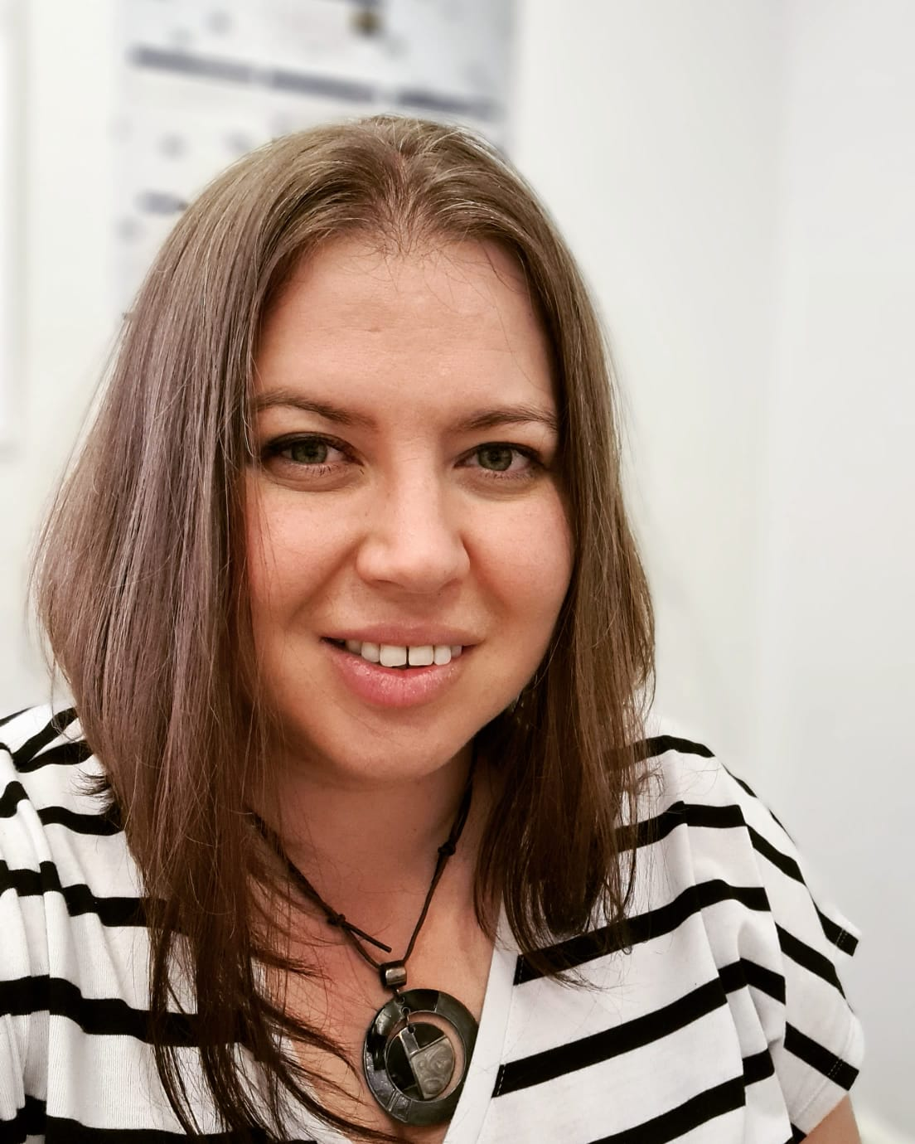
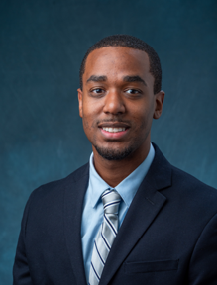
Your instructors
Dr. Emily Nordmann
University of Glasgow
Dr. Javan Carter
RTI International

Slide 3
Intro to R and Data Visualization
Designed for researchers with no knowledge of R or other programming languages
Some basic computer and statistical literacy assumed
Further resources provided to tailor the learning experience to diverse backgrounds

Slide 4
Learning Outcomes
By the end of this course, you will be able to:
Perform basic data wrangling using R
Produce summaries of data using R
Produce informative data visualisations using R
This course will not:
Cover inferential statistical tests in R
Require use of the All of Us Researcher Workbench

Slide 5
Course materials
Type | Starting programming proficiency
Type | Novice/beginner | Intermediate/advanced
Online workbook |  | 
Walkthrough videos |  | As desired
Reading |  | 
Further resources | As desired | 
Live office hour sessions | As desired | As desired
Completion quiz |  | 

Slide 6
Syllabus

Slide 7
Week 1
Installing R and RStudio
Install R and RStudio
Update R, Rstudio, and packages
Intro to R and Rstudio
Install add-on packages
Get help for packages and functions
Create objects by writing and running code in the console
Intro to Data Viz
Create and manage projects
Understand the grammar of ggplot
Produce and customize a range of visualizations
No live session in Week 1

Slide 8
Week 2
Data Summaries
Calculate descriptive statistics for a range of data types
Manage missing values
Advanced Data Viz
Transform simple data sets from wide-form to long-form
Create and customize advanced types of plots
Live office hour 1
Check workbook chapter for date and time and Zoom link
Workbook Q&A with Emily
All of Us Researcher Workbench Q&A with Javan
Ask questions on the day or submit Q&A form in advance
Ensure you have worked through Week 1 before attending

Slide 9
Week 3
No workbook content in week 3
Live office hour 2
Check workbook chapter for date and time and Zoom link
Workbook Q&A with Emily
All of Us Researcher Workbench Q&A with Javan
Ask questions on the day or submit Q&A form in advance
Ensure you have worked through Week 2 before attending
Completion quiz
20-item multiple-choice quiz
Immediate feedback and score
Course completion awarded for participation not score
Please use name and email address registered with All of Us Researcher Academy

Slide 10
Contact information
If you have any questions about this course, please contact:
Emily.Nordmann@glasgow.ac.uk

